Slide 1


Mini Project –Seminar On
“Smart Quiz Arena”
Dept. of CS&E ( DATA SCIENCE)
Adichunchanagiri Institute of Technology
Chikkamagaluru - 577102
Presented By,
Group 2,
Arun Kumar K S (4AI23CD003) Under the Guidance of
C K Yeshas (4AI23CD010) Asst Prof Harshitha H D
Shashikumar T A (4AI23CD049) Dep of Data Science
Sudeep S(4AI23CD056) AIT, CKM

Slide 2

Smart-Quiz Arena

Slide 3
CONTENTS
Problem definition
Scope of the Project
Project Design
Methodology
Tools And Technology
Implementation
Challenges faced
Result
Conclusion
Future Work
Question

Slide 4
Problem Definition
This project aims to design and implement a Smart Quiz Arena where users can participate in quizzes, attempt coding challenges, receive instant scores, and compete in real time. The platform provides a clean and user-friendly experience with features such as multiplayer quiz participation, coding challenges, and progress tracking, making it useful for students and learners to enhance their skills.

Slide 5
Scope of the Project
Key Areas the Project Focuses On
Quiz participation with difficulty levels
Coding challenges and problem-solving
Real-time multiplayer participation
Core Functionalities
Generate quizzes with scoring and timers
Execute coding challenges
Update leaderboards and rankings
Support single-player and multiplayer modes
Benefits
Improved learning
Skill enhancement
Continuous progress tracking

Slide 6
Project Design
Hardware
Device with 4GB RAM
Stable internet connection
Frontend
HTML, CSS, JavaScript
Quiz pages, coding editor, leaderboard
Timers and basic UI features
Backend
Django for server operations
WebSocket for real-time multiplayer
APIs for login, scoring, and code checking
Database
SQLite for users, questions, coding tasks, and scores

Slide 7
Modules
JSON
WebSocket
Code Execution System
AI Question Generator (Gemini API)
Timer Functions

Slide 8
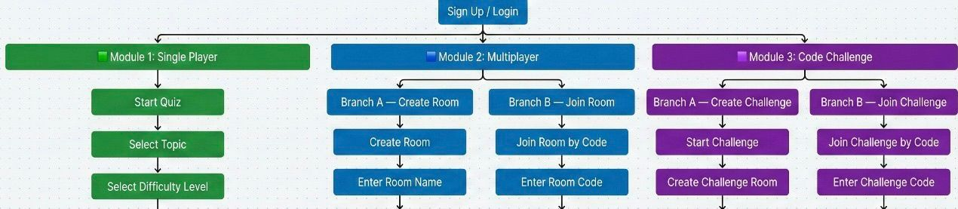
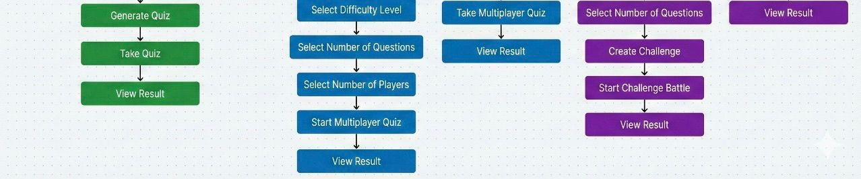
Block Diagram

Slide 9
Methodology
Requirement Analysis: Decided what features the system should have
Frontend: UI, quiz pages, coding editor
Backend: Django, WebSocket, Gemini API
Database: SQLite setup
Testing: Quiz, coding, timers, multiplayer

Slide 10
Tools and Technologies Used
Frontend
HTML & CSS
JavaScript
Backend
Django
WebSocket
Database
SQLite
AI Integration
Gemini API

Slide 11
Implementation
Login system for Users
Quizzes are generated by AI and coding tasks loaded from the database
Real-time multiplayer quiz support
Automatic quiz evaluation and scoring
Coding execution with test cases
Leaderboard updates in real time
Dashboard for viewing progress
Admin manages coding tasks; AI generates quiz questions

Slide 12
Challenges Faced
Frontend and backend were not syncing smoothly in real time
Multiplayer quiz progress was not matching between players
Leaderboard scores were not updating instantly
Database responses were slow during heavy usage

Slide 13
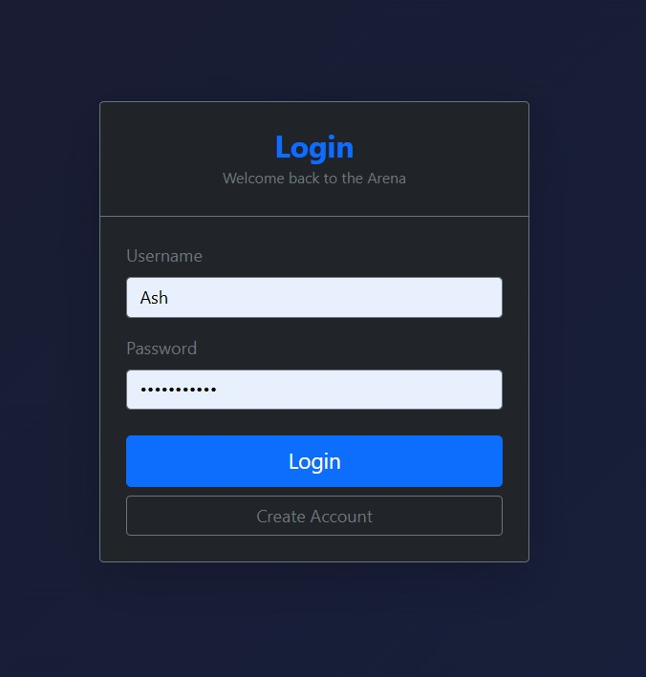
Result
Login interface for accessing Smart Quiz Arena

Slide 14
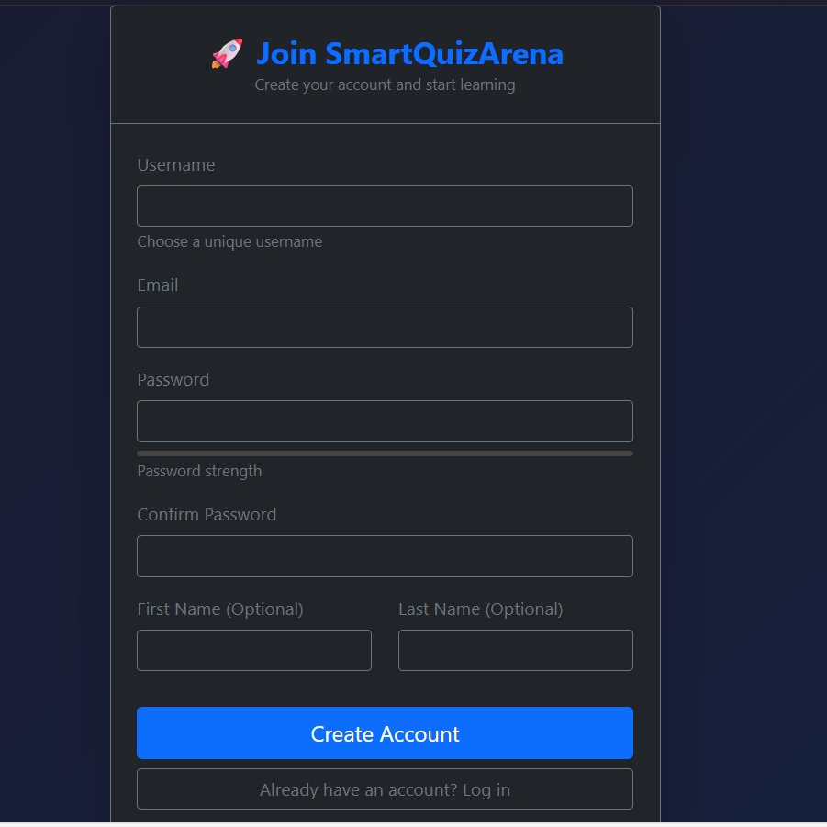
User registration interface for Smart Quiz Arena

Slide 15
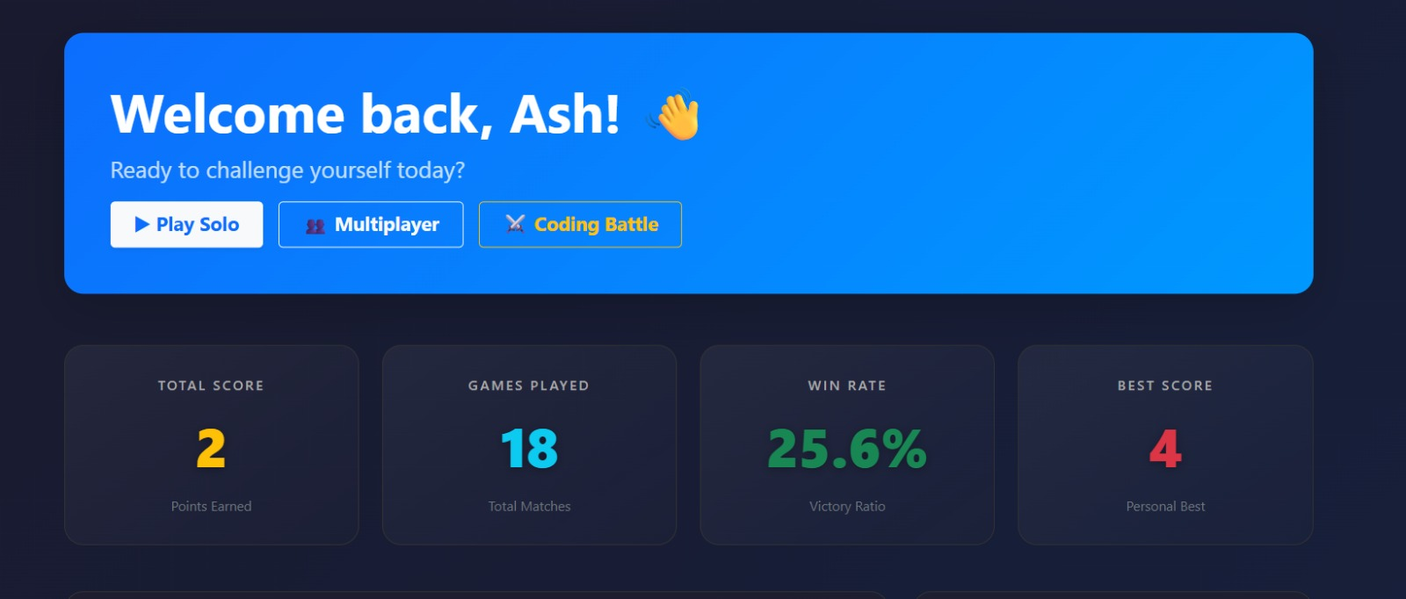
Home Page of the Smart Quiz Arena Platform

Slide 16
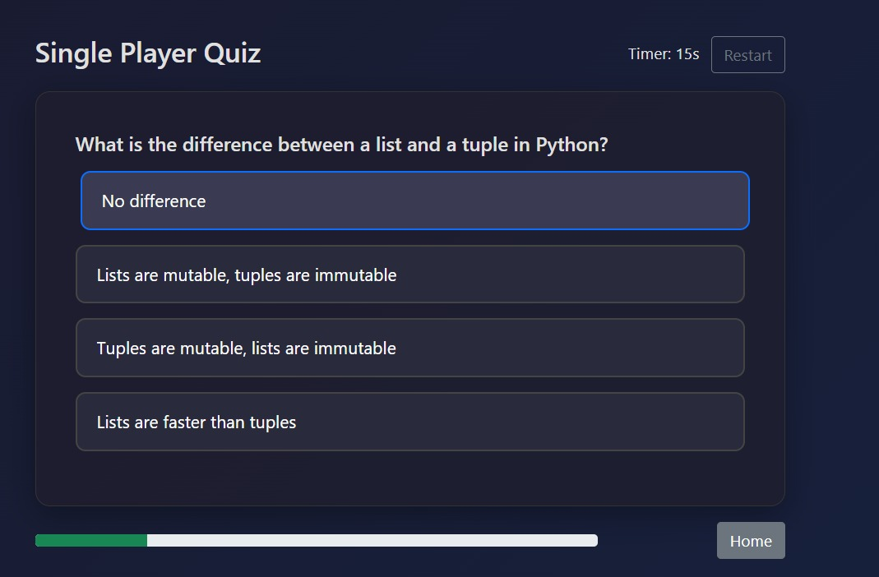
Single Player Quiz Interface of Smart Quiz Arena

Slide 17
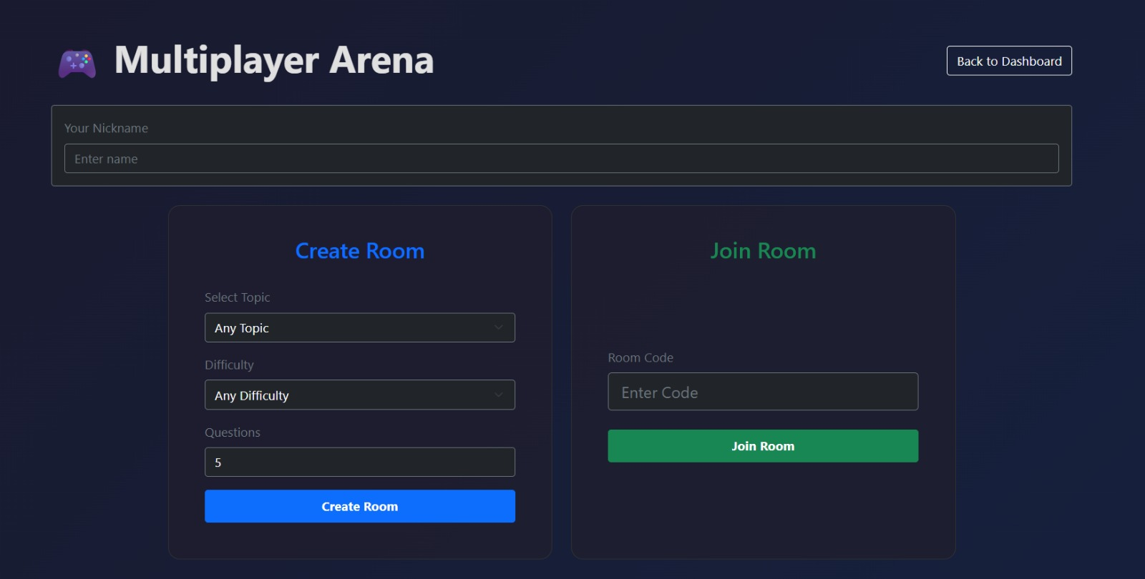
Screen for creating or joining real-time multiplayer quiz rooms

Slide 18
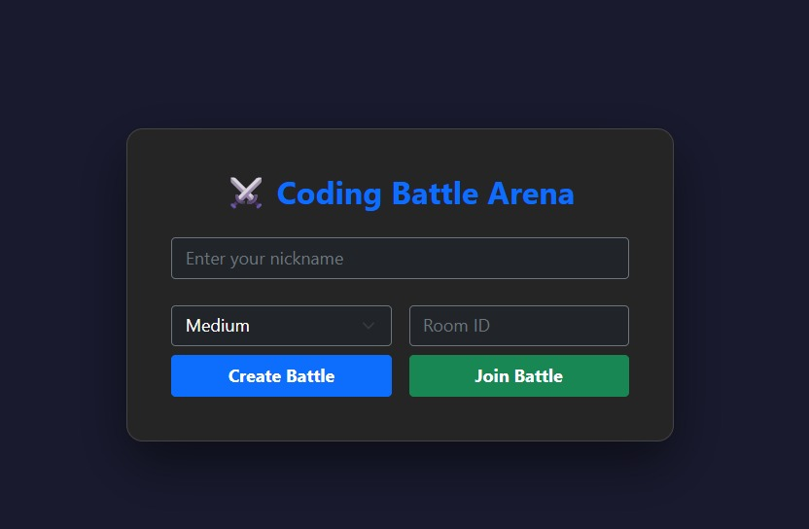
Code Battle Arena interface for creating or joining coding battles

Slide 19
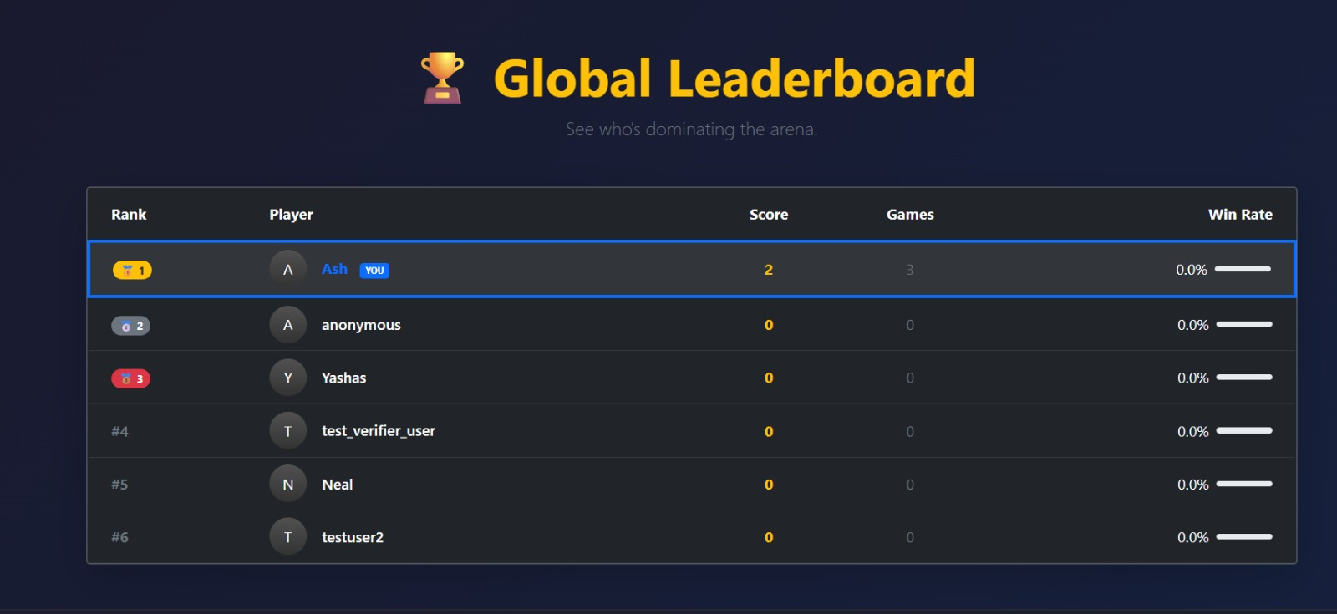
Real-time leaderboard displaying ranks, scores, and streaks

Slide 20
Conclusion
The Smart Quiz Arena provides a platform where users can test their knowledge through quizzes, coding challenges, real-time competitions, and quick results. With a simple user interface, fast backend system, and real-time features, the platform helps users learn better and stay active. Coding quizzes and basic gamification support the learning process.

Slide 21
Future Work
More quiz categories and modes
Adaptive difficulty system
Mobile app version (Android & iOS)
Analytics dashboard
Offline quiz support
AI-powered enhancements

Slide 22
GitHub Link
Arun Kumar K S:https://github.com/arunkumar
C K Yeshas: https://github.com/ckyeshas
Shashikumar T A: https://github.com/Shashikumarrajurs
Sudeep S: https://github.com/sudeep2596

Slide 23
Thank You
Questions?

